Slide 1
DATA ANALYST PORTFOLIO PROJECT
Customer Churn Analysis
An End-to-End Exploratory Data Analysis to understand why customers leave, and how a telecom business can reduce churn.
Prepared by: Swati Singh
Project Type: Individual Data Analytics Project | Dataset: Telco Customer Churn
TOOLS USED
Python
Pandas
NumPy
Matplotlib
Seaborn

Slide 2
THE PROBLEM
Business Understanding
What is Customer Churn? Churn simply means a customer stops using a company's service. In this project, churn means a telecom customer cancelled their connection and left the company.
1
2
3
Why It Matters
Business Problem
Project Objective
Getting a new customer costs much more than keeping an old one. If a business knows who is likely to leave, it can act early and save that customer.
The company does not know which customers are about to leave, or what is pushing them away. This leads to lost revenue every month.
To study customer data, find the real patterns and reasons behind churn, and turn them into simple insights the business can act on.
Customer Churn Analysis
2

Slide 3
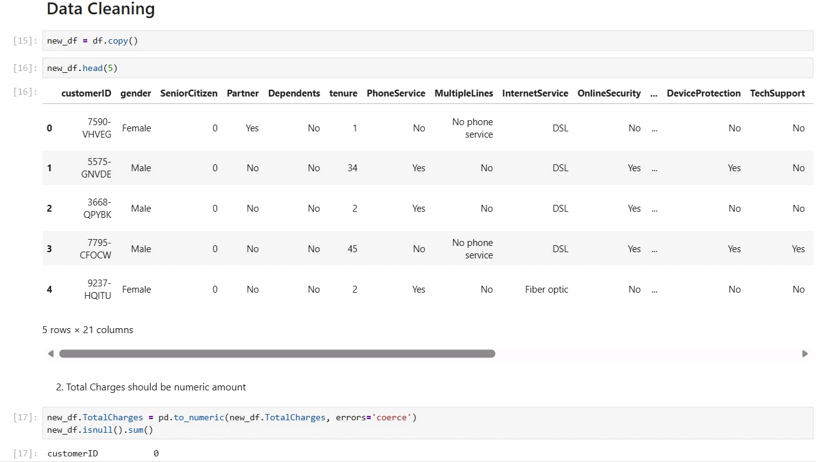
THE DATA
Dataset Understanding
7,043
Customer Records (rows)
21
Columns collected per customer
Churn
Target Variable (Yes / No)
First 5 rows of the dataset (21 columns)
Is the Target Variable Balanced?
No it is imbalanced. About 73% of customers did NOT churn and only 27% churned. This means “Churn = Yes” is the minority group, so any conclusion or model built on this data must treat that smaller group carefully, or it may miss real churn cases.
Data types: a mix of text/categorical columns (like gender, Contract, PaymentMethod) and numeric columns (like tenure, MonthlyCharges, TotalCharges).
Important features: tenure, MonthlyCharges, TotalCharges, Contract, InternetService, PaymentMethod, OnlineSecurity, TechSupport.
Customer Churn Analysis
3

Slide 4
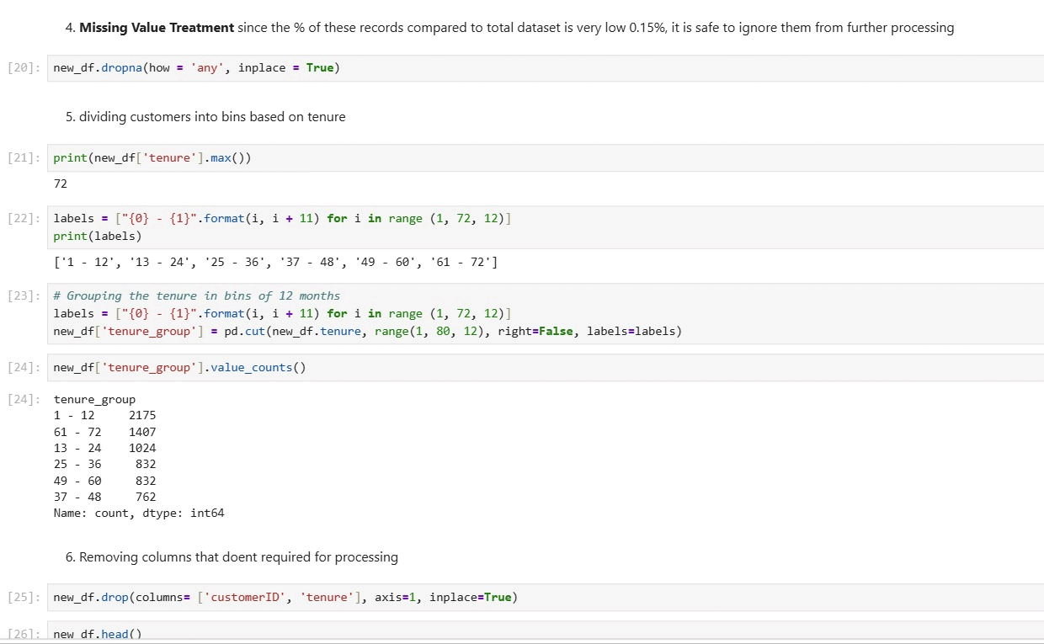
GETTING THE DATA READY
Data Cleaning & Preprocessing
1. Fixed TotalCharges Format
2. Handled Missing Values
TotalCharges was stored as text, not numbers, because some cells had blank spaces instead of a value. It was converted into a proper numeric column using pd.to_numeric().
This conversion created a small number of missing values — only 0.15% of all rows (11 out of 7,043). Since this is such a tiny share, these rows were safely dropped.
Converting TotalCharges to numeric
3. Grouped Tenure into Bins
4. Removed Unneeded Columns
The tenure column (in months) was grouped into 6 easy bins of 12 months each: 1-12, 13-24, 25-36, 37-48, 49-60, and 61-72. This makes the loyalty pattern much easier to read.
customerID was dropped because it is just an ID with no analysis value, and the raw tenure column was dropped once tenure_group was created from it.
Tenure grouped into 6 bins
Customer Churn Analysis
4

Slide 5
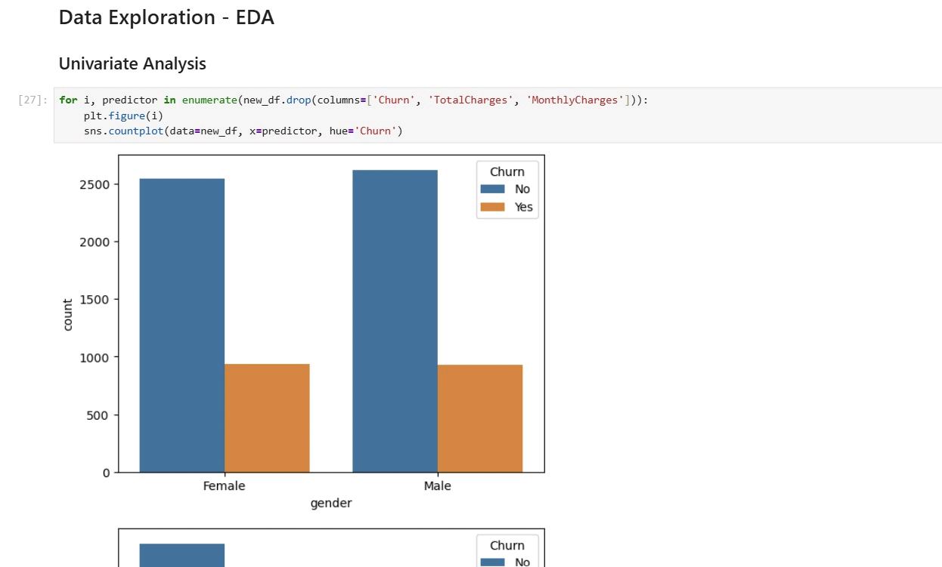
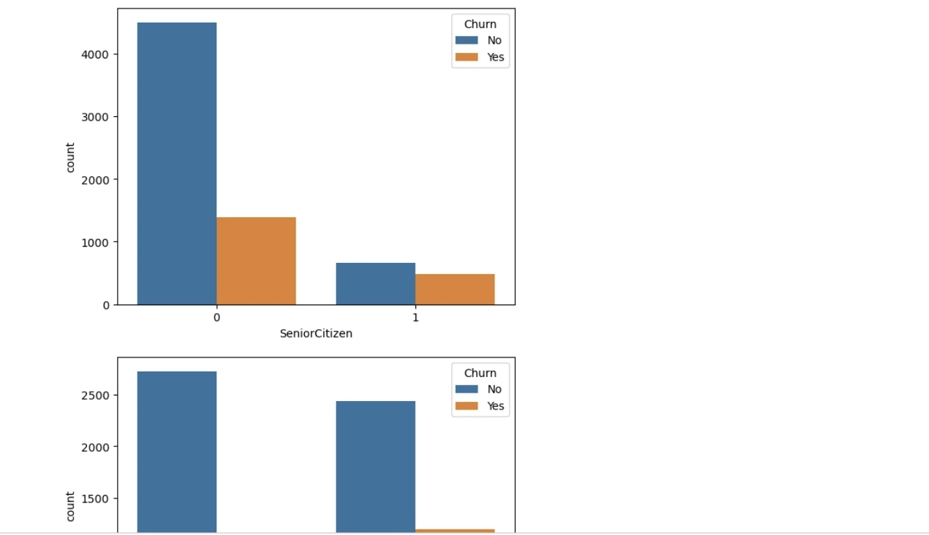
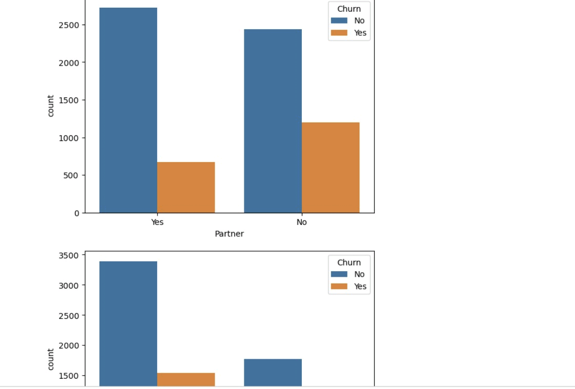
EXPLORATORY DATA ANALYSIS
Univariate Analysis — Customer Profile
Each chart below looks at one customer feature at a time, split by Churn (blue = stayed, orange = left).
Gender
Senior Citizen
Partner
KEY INSIGHTS
Gender: churn is almost equal for males and females (about 26% each). Gender does not affect churn.
Senior Citizen: senior citizens churn at a much higher rate (~42%) than non-seniors (~24%) even though non-seniors have more churners in total, simply because there are far more non-senior customers overall.
Partner: customers with no partner churn noticeably more than customers who have a partner, suggesting single customers are less “attached” to the service.
Customer Churn Analysis
5

Slide 6
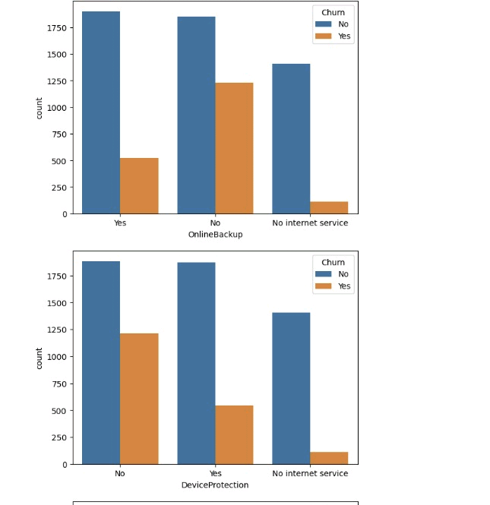
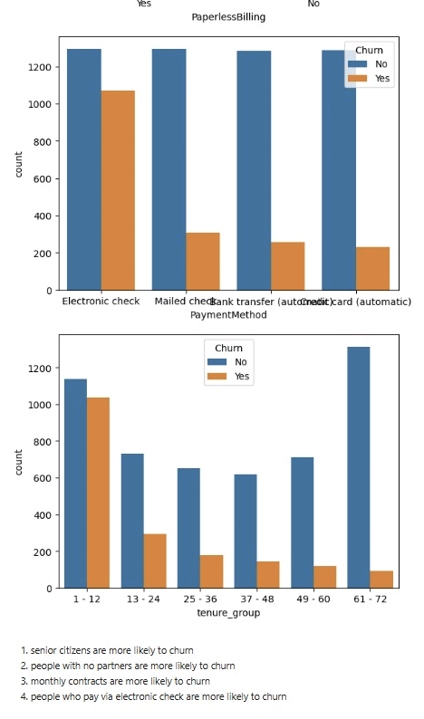
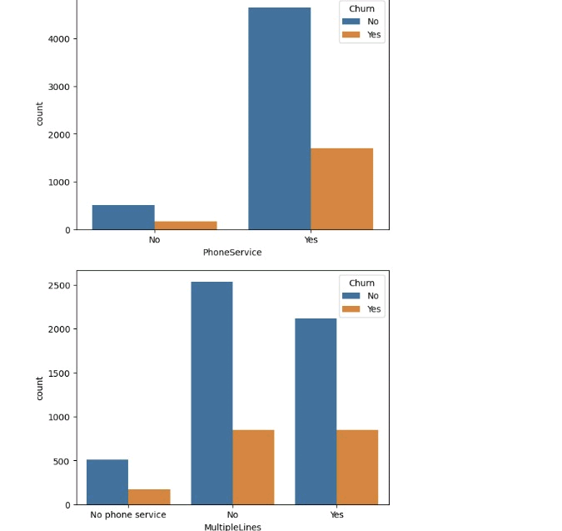
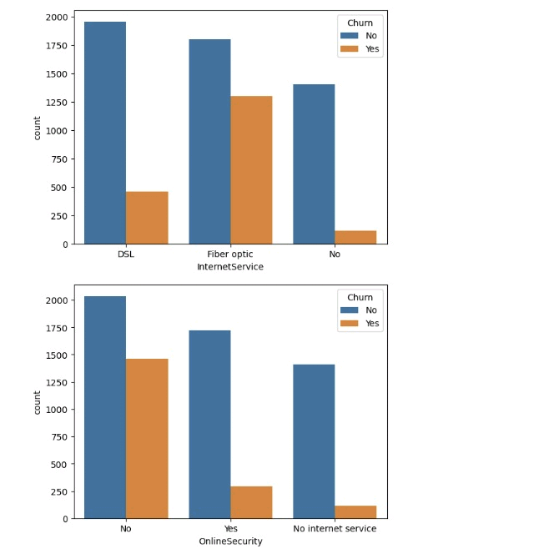
EXPLORATORY DATA ANALYSIS
Univariate Analysis — Services & Billing
Online Backup & Device Protection
Payment Method & Tenure Group
Phone Service & Multiple Lines
Internet Service & Online Security
KEY INSIGHTS
Phone service and multiple lines barely change churn not a strong driver.
Fiber optic customers churn the most; DSL churns less; no-internet customers churn the least.
No Online Security, No Online Backup and No Device Protection all show much higher churn than customers who have these add-ons.
Electronic check payers churn the most of all payment methods.
New customers (tenure 1-12 months) churn the most; long-time customers (61-72 months) churn the least loyalty clearly builds over time.
Customer Churn Analysis
6

Slide 7
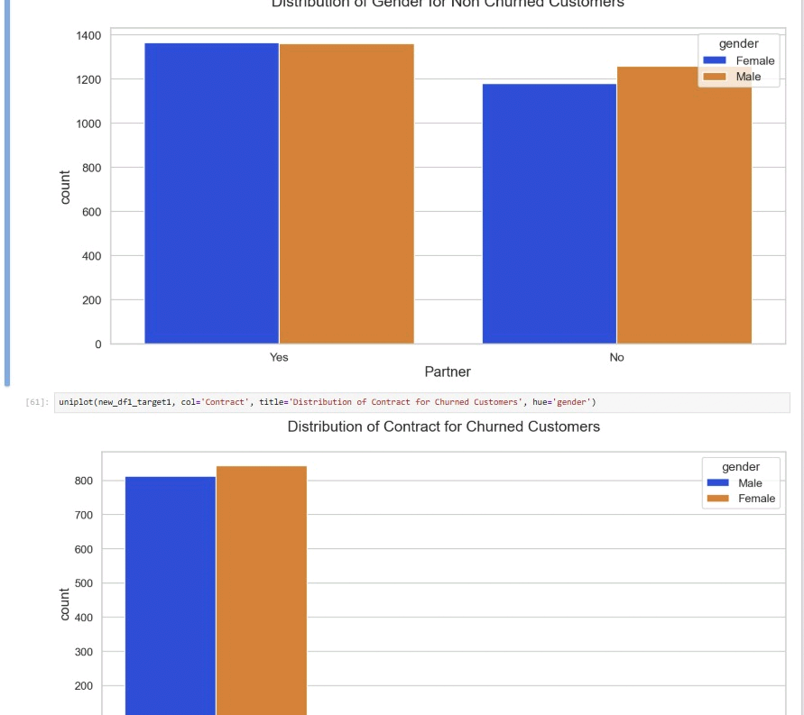
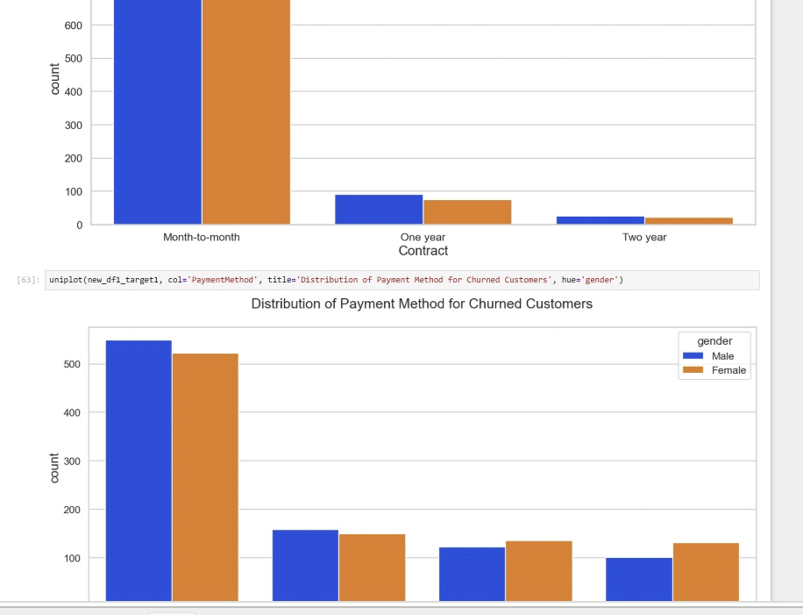
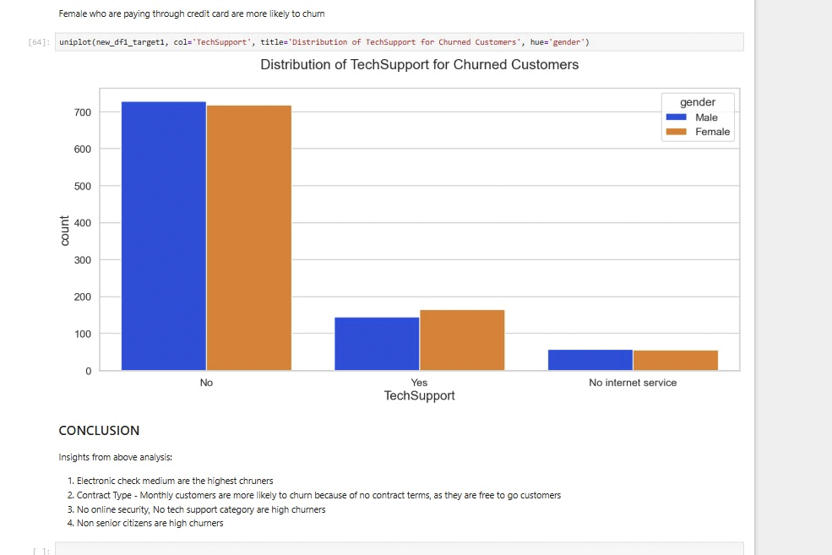
FOCUSED ON CHURNED CUSTOMERS
Categorical Analysis — A Closer Look
These charts zoom into only the churned customers, and break them down further by gender.
Gender split, by Partner status
Contract & Payment Method
Tech Support
KEY INSIGHTS
Among churned customers, the male/female split is almost even gender is not a driver of who churns.
Almost every churned customer was on a Month-to-Month contract; One year and Two year contracts saw very few churners.
Electronic check is by far the most common payment method among churned customers, more than double any other method.
Most churned customers had No Tech Support; customers who had Tech Support churned far less.
Customer Churn Analysis
7

Slide 8
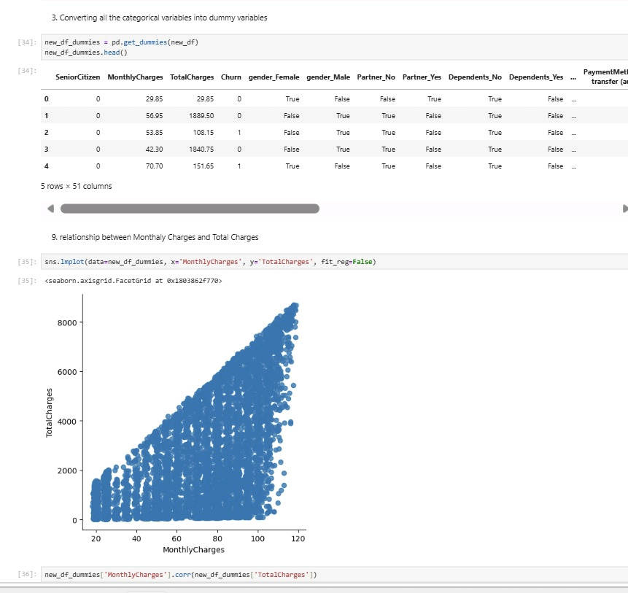
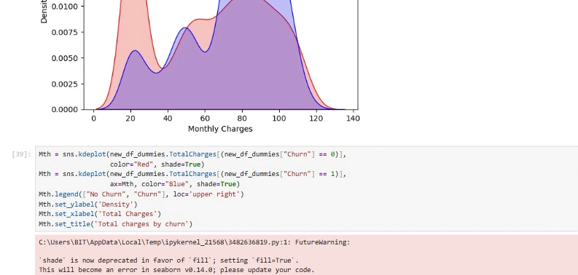
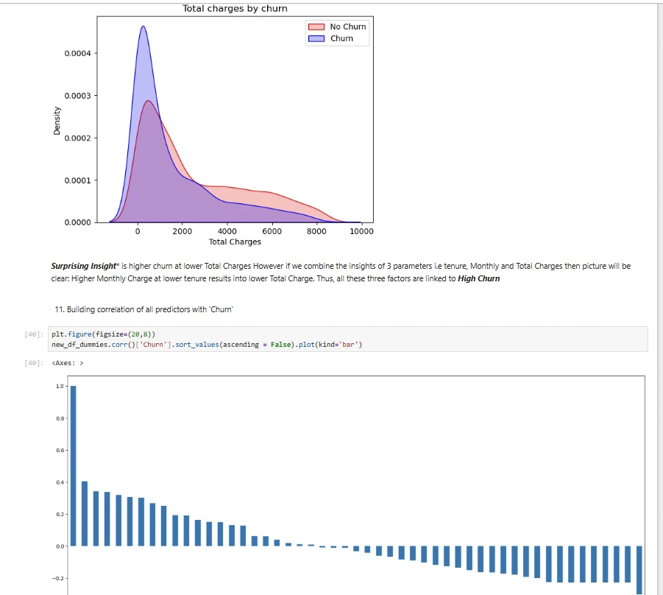
CHARGES & DISTRIBUTIONS
Numerical Analysis
MonthlyCharges vs TotalCharges
Monthly Charges by Churn
Total Charges by Churn
KEY INSIGHTS
Monthly vs Total Charges: a strong positive relationship customers who pay more per month also build up higher total charges, which makes sense since total charges add up from monthly charges over time.
Monthly Charges by Churn: churned customers cluster around the higher charge range (₹70-100), while loyal customers peak at the low end (~₹20). Higher monthly bills raise churn risk.
Total Charges by Churn (surprising insight): churned customers actually show LOWER total charges. This is not a contradiction it happens because churned customers pay high monthly bills but leave early (low tenure), so their total spend never grows large.
No extreme outliers were found in either charge column both distributions are smooth, with no unusual spikes.
Customer Churn Analysis
8

Slide 9
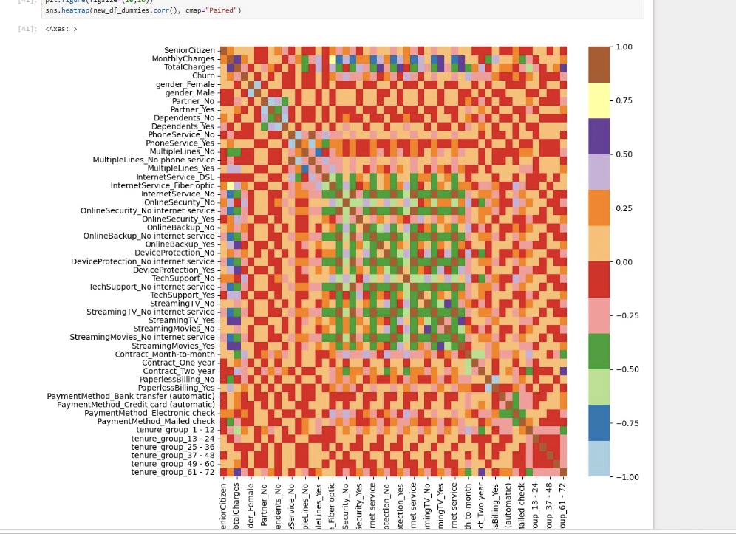
EVERY FEATURE VS CHURN
Bivariate Analysis
HOW TO READ THIS
This chart ranks every feature by how strongly it relates to Churn. Bars above zero push churn up, bars below zero pull churn down.
RAISES CHURN RISK
Month-to-month contract
Fiber optic internet
Payment by Electronic check
LOWERS CHURN RISK
Long tenure (61-72 months)
Two year contract
Having Online Security / Tech Support
Correlation of each predictor with Churn
Customer Churn Analysis
9

Slide 10
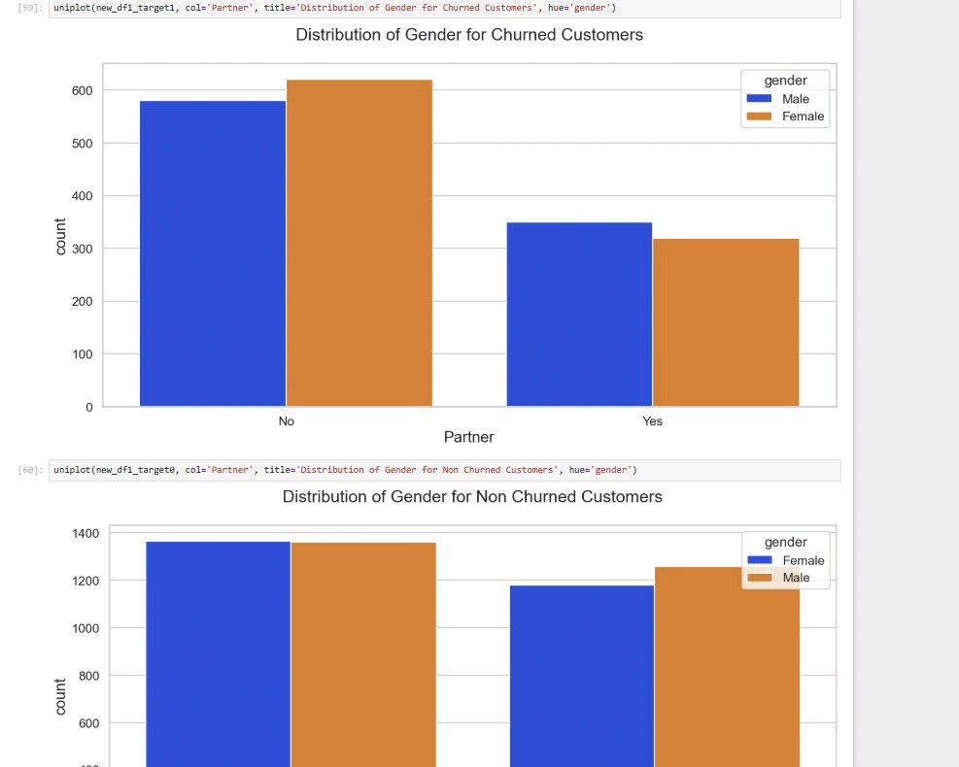
FULL CORRELATION HEATMAP
Correlation Analysis
POSITIVE CORRELATION
MonthlyCharges is positively correlated with Fiber optic internet fiber customers usually pay more per month.
NEGATIVE CORRELATION
Long tenure groups and Two year contracts are negatively correlated with Churn as these go up, churn goes down.
DERIVED INSIGHT
High churn clusters around month-to-month contracts, no online security, no tech support, first-year customers, and fibre optic internet. Low churn clusters around long contracts, no-internet subscriptions, and customers who stayed 5+ years.
Gender, phone service and multiple lines show almost no relationship with churn.
Correlation heatmap of all features
Customer Churn Analysis
10

Slide 11
PUTTING IT ALL TOGETHER
Key Business Insights
1
Senior citizens churn at a much higher rate than non-senior citizens.
2
Month-to-month contracts drive the most churn; long-term contracts build loyalty.
3
Customers without a partner churn more than customers with a partner.
4
Electronic check is the highest-risk payment method for churn.
5
No Online Security or No Tech Support strongly increases churn.
6
Fiber optic internet customers churn more than DSL or no-internet customers.
7
Higher Monthly Charges raise churn risk, but churned customers show lower Total Charges since they leave early.
8
New customers (first 12 months) are the highest-risk group for churn.
9
Monthly Charges and Total Charges are strongly and positively correlated.
Customer Churn Analysis
11

Slide 12
WHAT THE COMPANY SHOULD DO
Business Recommendations
1
2
3
Push Long-Term Contracts
Protect New Customers
Support Senior Citizens
Offer discounts or perks to move month-to-month customers onto yearly or two-year plans, since these customers churn the least.
Create a welcome/loyalty program for the first 12 months — this is the highest-risk window for losing a customer.
Design simpler plans and a dedicated support line for senior citizens, who churn at a much higher rate.
4
5
6
Bundle Add-On Services
Fix the Electronic Check Experience
Watch High-Risk Spenders
Offer free or low-cost Online Security and Tech Support with Fiber optic plans to reduce churn in that segment.
Investigate pain points in electronic check payments, and encourage customers to move to auto-pay methods.
Proactively reach out to customers with high monthly charges and low tenure before they decide to leave.
Customer Churn Analysis
12

Slide 13
CONCLUSION
Project Summary
Objective Achieved: This project studied end-to-end telecom customer data to understand and explain customer churn — from cleaning raw data to finding clear, business-ready insights.
Major Findings
Business Value
Tools & Skills Used
Contract type, tenure, internet service, payment method and add-on services (like Tech Support) are the biggest drivers of churn. Gender and phone service barely matter.
The company can target the right customers with the right retention offer at the right time, instead of guessing reducing revenue lost to churn.
Python, Pandas and NumPy for data cleaning and feature engineering; Matplotlib and Seaborn for univariate, bivariate and correlation analysis.
Customer Churn Analysis
13

Slide 14
Thank You
Customer Churn Analysis | Data Analyst Portfolio Project
Swati Singh | swatisingh221006@gmail.com | linkedin.com/in/swati-singh-453277320

